Slide 1
MS DOS
Microsoft Disk Operating System

Slide 2
History
Created in 1980 by Tim Paterson
Purchased by Microsoft and launched in 1981
Operating system for IBM PCs

Slide 3
DOS
Written in C, Assembly, and x86-based language
SIngle command operating system
Used to access optical, floppy, and hard disk drives
16-bit OS
File manager (creating, editing, deleting, etc)
Does NOT support GUI
Single User OS
Text-based interface

Slide 4
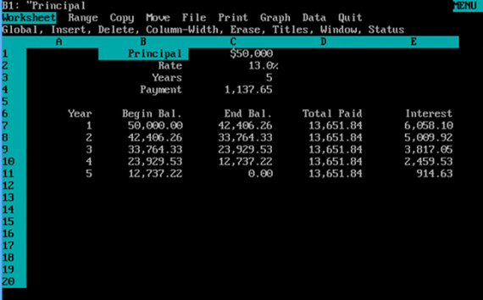
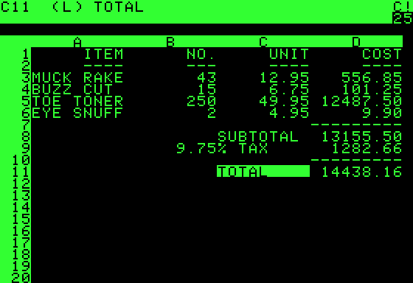
Lotus 1-2-3

Slide 5
DOS Commands
ECHO, PROMPT, MKDIR, CD, CHDIR,
EDIT, DIR, DEL, RM, RMDIR, TYPE,
SHUTDOWN, MOVE, DELTREE

Slide 6
Why is Dos a thing in 2023?
To run legacy software
Develop embedded systems
AND……..

Slide 7
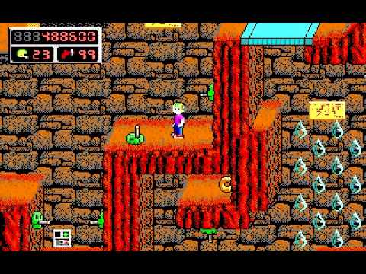
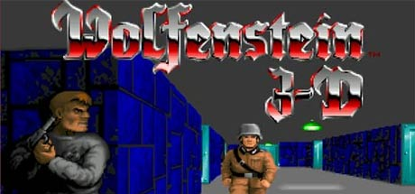
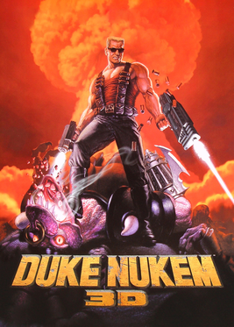
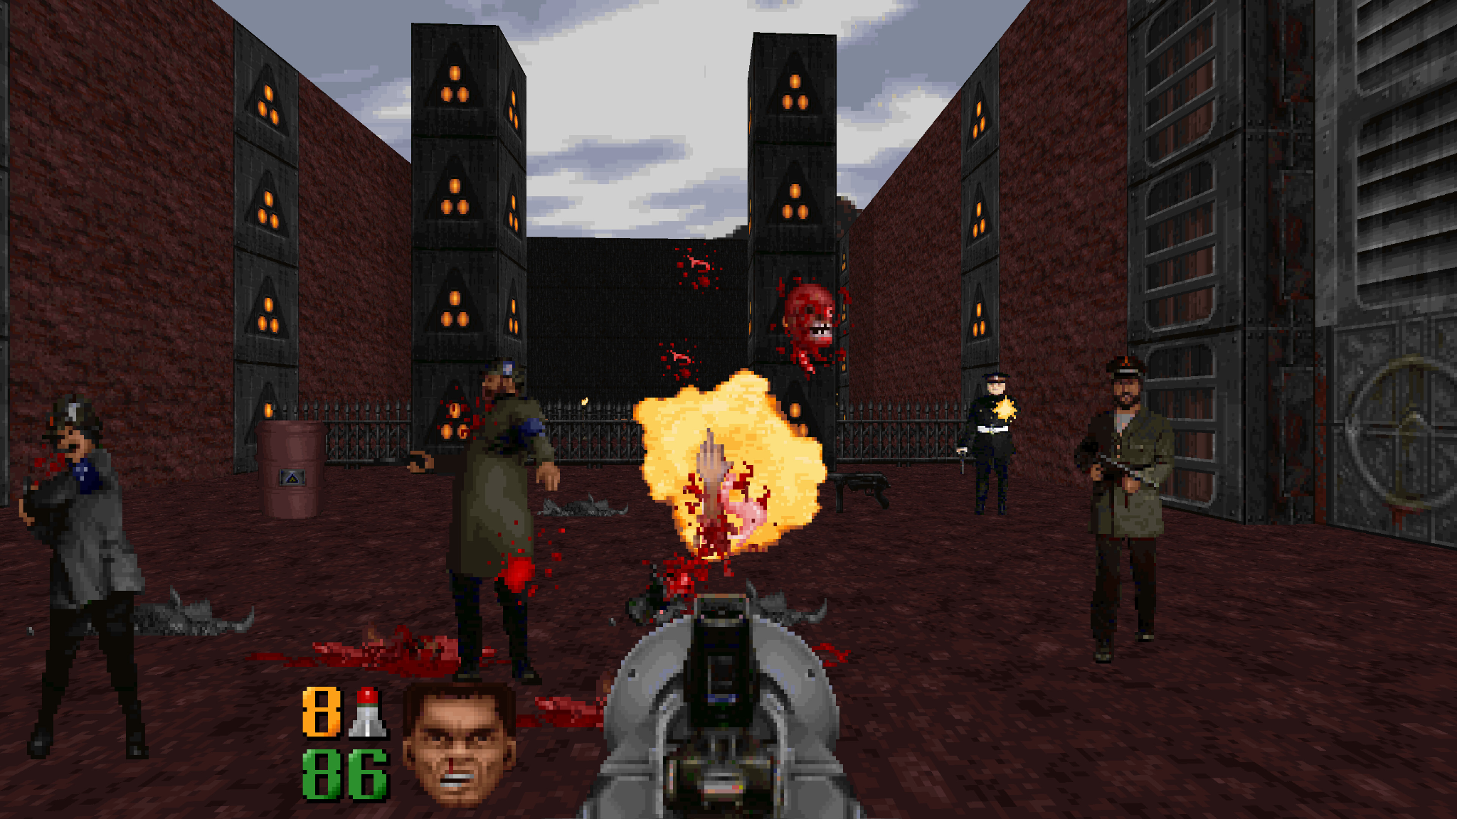
Gaming

